Slide 1

Wheat genomics workshop
Philippa Borrill
@PhilippaBorrill

Slide 2
Outline
Genome assemblies
Expression tools
Practical session

Slide 3
1. Genome assemblies

Slide 4
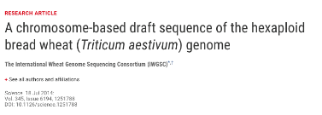

3 generations of wheat genome assemblies
 | CSS
Release date | IWGSC, 2014
Notes:
There are more wheat genome assemblies out there.
Here we decided to focus on the ones for which a gene annotation is available and thus the ones that were and/or are still used as references in the community
First International Wheat Genome Sequencing Consortium published the first chromosome-based assembly for wheat

Slide 5

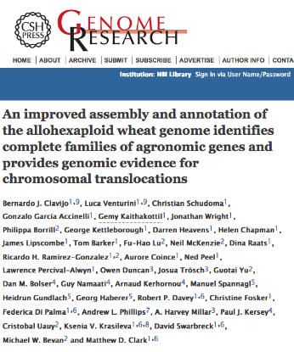
3 generations of wheat genome assemblies
 | CSS | TGACv1
Release date | IWGSC, 2014 | Clavijo et al., 2017
Notes:
Then last year TGAC, now EI, published an improved assembly with better contiguity

Slide 6


3 generations of wheat genome assemblies
 | CSS | TGACv1 | RefSeqv1.0
Release date | IWGSC, 2014 | Clavijo et al., 2017 | IWGSC, 2018
IWGSC 2018, Science (in press)
Notes:
The last but not the least, the RefSeq assembly made by the IWGSC and currently under review.
Although this was available since almost two years now under the Toronto agreement

Slide 7
Chromosome Survey Sequencing
 | CSS | TGACv1 | RefSeqv1.0
Release date | IWGSC, 2014 | Clavijo et al., 2017 | IWGSC, 2018
Notes:
So let us have a look at the first one – identify pros and cons to have a base for comparison against the most recent ones
It’s name: Chromosome Survey Sequencing – what does it mean?
Wheat chromosome were first flow sorted – meaning that they were physically separated and each one was individually sequenced
This is to facilitate the assembly step

Slide 8
CSS is highly fragmented
 | CSS | TGACv1 | RefSeqv1.0
Release date | IWGSC, 2014 | Clavijo et al., 2017 | IWGSC, 2018
Flow sorted chromosomes
> 1 million contigs!
Median contig length ~7 kb (after repeat masking)
Assembled 10.2 Gb (out of ~15 Gb)
Notes:
However this assembly was still highly fragmented and we miss almost 5Gb

Slide 9
We only have a rough idea of the contig order
 | CSS | TGACv1 | RefSeqv1.0
Release date | IWGSC, 2014 | Clavijo et al., 2017 | IWGSC, 2018
Flow sorted chromosomes
> 1 million contigs!
Median contig length ~7 kb (after repeat masking)
Assembled 10.2 Gb (out of ~15 Gb)
chr1B
Os06g0189600
Notes:
If I compare it with chromosome-level assemblies as for Arabidopsis, this is how it would look like
We have a very crude order – so we know which chromosome the contigs are from thanks to the flow sorting and then they were genetically assigned to small linkage group as shown here.
But within a group we do not know the correct order

Slide 10
CSS: summary
 | CSS | TGACv1 | RefSeqv1.0
Release date | IWGSC, 2014 | Clavijo et al., 2017 | IWGSC, 2018
Highly fragmented
Crude order
Not reliable
Notes:
Take home for CSS

Slide 11
… but resources still use CSS gene models as ref
 | CSS
Release date | IWGSC, 2014
# contigs/ chromosomes | > 1 million
Mean scaffold size | 7.7 kb
Assembly Size | 10.2 Gb
Order | Crude order
Gene names | Traes_1BL_447468BDE
# Coding genes | 100,934
TGACv1 | RefSeqv1.0
Clavijo et al., 2017 | IWGSC, 2018
Notes:
So why bothering presenting it today?
Well because at that time it was already a major step to have a reference assembly for wheat!
More importantly, even though we knew it was not perfect, we could start annotate genes and use the models as a common reference for wheat researchers
Some of these resources are still using these gene models as a reference – although most of them are now in the transition process to move to the more recent assemblies

Slide 12
CSS gene models: nomenclature
 | CSS
Release date | IWGSC, 2014
# contigs/ chromosomes | > 1 million
Mean scaffold size | 7.7 kb
Assembly Size | 10.2 Gb
Order | Crude order
Gene names | Traes_1BL_447468BDE
# Coding genes | 100,934
TGACv1 | RefSeqv1.0
Clavijo et al., 2017 | IWGSC, 2018
Species designation: Traes is short for
Triticum aestivum
Unique ID
Traes_1BL_447468BDE
Chromosome
location
Notes:
So if it is not reliable, why presenting it?

Slide 13
Resources using CSS gene models
 | CSS
Release date | IWGSC, 2014
# contigs/ chromosomes | > 1 million
Mean scaffold size | 7.7 kb
Assembly Size | 10.2 Gb
Order | Crude order
Gene names | Traes_1BL_447468BDE
# Coding genes | 100,934
Resources | Archive EnsemblPlants
 | TILLING mutants
 | expVIP
Accession | Chinese Spring
TGACv1 | RefSeqv1.0
Clavijo et al., 2017 | IWGSC, 2018
TILLING mutants: www.wheat-tilling.com
Expression browser: www.wheat-expression.com
More details and tutorials on: www.wheat-training.com
Notes:
Still available on archive Ensembl Plant if you really want to use it but bear in mind this one is now obsolete
Resources such as expVIP (gene expression browser, Sophie will tell you more about it later) and TILLING mutant database (Jemima) still use these gene models
Finally, sequenced accession is Chinese Spring and it will be the same for all assemblies for consistency and comparison purposes

Slide 14
TGACv1
 | CSS
Release date | IWGSC, 2014
# contigs/ chromosomes | > 1 million
Mean scaffold size | 7.7 kb
Assembly Size | 10.2 Gb
Order | Crude order
Gene names | Traes_1BL_447468BDE
# Coding genes | 100,934
Resources | Archive EnsemblPlants
 | TILLING mutants
 | expVIP
Accession | Chinese Spring
TGACv1 | RefSeqv1.0
Clavijo et al., 2017 | IWGSC, 2018
TILLING mutants: www.wheat-tilling.com
Expression browser: www.wheat-expression.com
More details and tutorials on: www.wheat-training.com
Notes:
Now let’s move on to the TGAC assembly

Slide 15
TGACv1
 | CSS
Release date | IWGSC, 2014
TGACv1 | RefSeqv1.0
Clavijo et al., 2017 | IWGSC, 2018
1BS
1BS
1BL
1BL
CSS
TGACv1
Notes:
This where we were with CSS

Slide 16
TGACv1
 | CSS
Release date | IWGSC, 2014
TGACv1 | RefSeqv1.0
Clavijo et al., 2017 | IWGSC, 2018
1BS
1BS
1BL
1BL
CSS
1BS
1BL
TGACv1
Larger bins – chromosome assignment based on CSS sequencing data
Notes:
This where we were with CSS

Slide 17
TGACv1: Better representation of the genome
 | CSS
Release date | IWGSC, 2014
TGACv1 | RefSeqv1.0
Clavijo et al., 2017 | IWGSC, 2018
735,943 scaffolds
Median contig length ~88.7 kb (after repeat masking)
Assembled 13.4 Gb (out of ~15 Gb)
Notes:
Less units, longer scaffolds, better representation of the genome

Slide 18
TGACv1: Significant improvement
 | CSS | TGACv1
Release date | IWGSC, 2014 | Clavijo et al., 2017
# contigs/ chromosomes | > 1 million | 735,943
Mean scaffold size | 7.7 kb | 88.7 kb
Assembly Size | 10.2 Gb | 13.4 Gb
Order | Crude order | Large Bins
Notes:
Major improvement

Slide 19
TGACv1: New gene annotation
 | CSS | TGACv1
Release date | IWGSC, 2014 | Clavijo et al., 2017
# contigs/ chromosomes | > 1 million | 735,943
Mean scaffold size | 7.7 kb | 88.7 kb
Assembly Size | 10.2 Gb | 13.4 Gb
Order | Crude order | Large Bins
Gene names | Traes_1BL_447468BDE | TRIAE_CS42_7DL_TGACv1_731555_AA2173560
# Coding genes | 100,934 | 104,390
Notes:
New gene annotation came along with this assembly and as for CSS I will describe in more details the gene names

Slide 20
TGACv1 gene models: nomenclature
 | CSS | TGACv1
Release date | IWGSC, 2014 | Clavijo et al., 2017
# contigs/ chromosomes | > 1 million | 735,943
Mean scaffold size | 7.7 kb | 88.7 kb
Assembly Size | 10.2 Gb | 13.4 Gb
Order | Crude order | Large Bins
Gene names | Traes_1BL_447468BDE | TRIAE_CS42_7DL_TGACv1_731555_AA2173560
# Coding genes | 100,934 | 104,390
Chromosome arm
assignment
TRIAE_CS42_7DL_TGACv1_731555_AA2173560
Species: TRIticum AEstivum
Accession: Chinese Spring
Assembly
version
Unique ID
Notes:
x

Slide 21
TGACv1 is the current reference on EnsemblPlants…
 | CSS | TGACv1
Release date | IWGSC, 2014 | Clavijo et al., 2017
# contigs/ chromosomes | > 1 million | 735,943
Mean scaffold size | 7.7 kb | 88.7 kb
Assembly Size | 10.2 Gb | 13.4 Gb
Order | Crude order | Large Bins
Gene names | Traes_1BL_447468BDE | TRIAE_CS42_7DL_TGACv1_731555_AA2173560
# Coding genes | 100,934 | 104,390
Resources | Archive EnsemblPlants | EnsemblPlants *
Includes SNP variation, gene trees, homoeolog assignments
Notes:
Available on Ensembl with all data

Slide 22
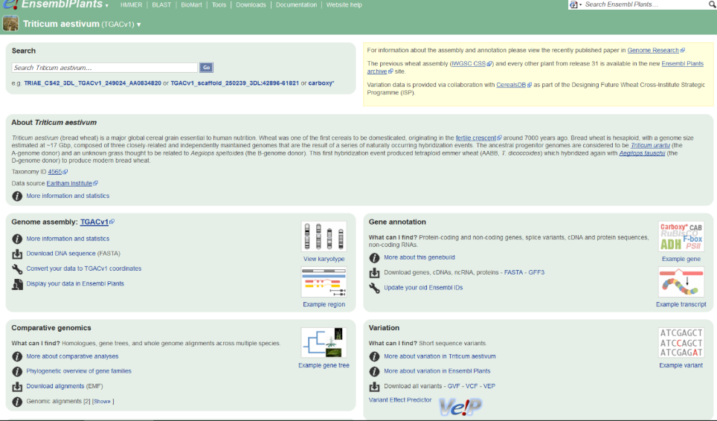
http://plants.ensembl.org/Triticum_aestivum/Info/Index
Notes:
Main page
You can have more info about assembly, gene annotation and download them
Also loads of cool features: BLAST search, orthologues search, gene trees – Sophie will tell you more about how to retrieve you Arabidopsis gene orthologue in wheat
SNP variations data

Slide 23
Available resources using CSS and TGACv1
 | CSS | TGACv1
Release date | IWGSC, 2014 | Clavijo et al., 2017
# contigs/ chromosomes | > 1 million | 735,943
Mean scaffold size | 7.7 kb | 88.7 kb
Assembly Size | 10.2 Gb | 13.4 Gb
Order | Crude order | Large Bins
Gene names | Traes_1BL_447468BDE | TRIAE_CS42_7DL_TGACv1_731555_AA2173560
# Coding genes | 100,934 | 104,390
Resources | Archive EnsemblPlants | EnsemblPlants *
 | TILLING mutants | TILLING mutants
 | expVIP | expVIP
Accession | Chinese Spring | Chinese Spring
Includes SNP variation, gene trees, homoeolog assignments
TGACv1 on Ensembl: http://plants.ensembl.org/Triticum_aestivum/Info/Index
TILLING mutants: www.wheat-tilling.com
Expression browser: www.wheat-expression.com
More details and tutorials on: www.wheat-training.com
Notes:
Also expression browser and TILLING …

Slide 24
RefSeqv1.0
 | CSS | TGACv1 | RefSeqv1.0
Release date | IWGSC, 2014 | Clavijo et al., 2017 | IWGSC, 2018
# contigs/ chromosomes | > 1 million | 735,943
Mean scaffold size | 7.7 kb | 88.7 kb
Assembly Size | 10.2 Gb | 13.4 Gb
Order | Crude order | Large Bins
Gene names | Traes_1BL_447468BDE | TRIAE_CS42_7DL_TGACv1_731555_AA2173560
# Coding genes | 100,934 | 104,390
Resources | Archive EnsemblPlants | EnsemblPlants *
 | TILLING mutants | TILLING mutants
 | expVIP | expVIP
Accession | Chinese Spring | Chinese Spring
Includes SNP variation, gene trees, homoeolog assignments
TGACv1 on Ensembl: http://plants.ensembl.org/Triticum_aestivum/Info/Index
TILLING mutants: www.wheat-tilling.com
Expression browser: www.wheat-expression.com
More details and tutorials on: www.wheat-training.com
Notes:
Now the last, but not the least – RefSeqv1.0

Slide 25
Comparison between IWGSC WGA v0.4 and RefSeq1.0
IWGSC WGA v0.4 (available since June 2016)
Illumina short sequence reads assembled with NRGene’s DeNovoMAGICTM software
POPSEQ data and a HiC map for chromosomal position assignment
Over 99% of CSS contigs map to the assembly
Notes:
Illumina sequencing and new assembler, BUT ALSO INTEGRATION OF PHYSICAL DATA: POPSEQ + HiC for the assembly
HiC: genome-wide chromatin interaction dataset. Rich source of long-range information for assigning, ordering and orienting genomic
sequences to chromosomes, including across centromere.

Slide 26
Comparison between IWGSC WGA v0.4 and RefSeq1.0
IWGSC WGA v0.4 (available since June 2016)
Illumina short sequence reads assembled with NRGene’s DeNovoMAGICTM software
POPSEQ data and a HiC map for chromosomal position assignment
Over 99% of CSS contigs map to the assembly
IWGSC RefSeq v1.0 (available since January 2017)
Integration of IWGSC WGA v0.4 with :
- Physical maps for all chromosomes;
- Sequenced BACs for 8 chromosomes (1A, 1B, 3B, 3D, 6B, 7A, 7B, 7D) and partial MTP BAC sequences for 2 chromosome arms (4AL, 5BS);
- MTP BAC WGPTM sequence tags for all chromosomes, except 3B;
- BioNano optical maps (7A, 7B, 7DS);
- Alignment to RH maps (D chromosomes)
- GBS map of the SynOp RIL population CsxRn genetic map (INRA).
Notes:
Illumina sequencing and new assembler, BUT ALSO INTEGRATION OF PHYSICAL DATA: POPSEQ + HiC for the assembly
HiC: genome-wide chromatin interaction dataset. Rich source of long-range information for assigning, ordering and orienting genomic
sequences to chromosomes, including across centromere.

Slide 27
Comparison between IWGSC WGA v0.4 and RefSeq1.0
Parameter | v0.4 | v1.0
Scaffold N50 (Number of scaffolds) | 7.1 Mbp (566) | 28.9 Mbp (147)
Total assembly size | 14.53 Gbp | 14.6 Gbp
Unfilled gaps (=%n) | 1.80% | 1.48%
sources:
https://wheat-urgi.versailles.inra.fr/Seq-Repository/Assemblies
http://nrgene.com/wp-content/uploads/2017/02/DeNovo2.0_Brochure.pdf

Slide 28
A chromosome-level assembly is here!
 | CSS | TGACv1 | RefSeqv1.0
Release date | IWGSC, 2014 | Clavijo et al., 2017 | IWGSC, 2018
21 chromosomes!
Assembled 14.6 Gb (out of ~15 Gb)
Notes:
Major step: we now have a chromosome-level assembly that is fairly representative of the whole genome

Slide 29
A chromosome-level assembly is here!
 | CSS | TGACv1 | RefSeqv1.0
Release date | IWGSC, 2014 | Clavijo et al., 2017 | IWGSC, 2018
21 chromosomes!
Assembled 14.6 Gb (out of ~15 Gb)
1BS
1BS
1BL
1BL
CSS
1BS
1BL
TGACv1
1B
RefSeqv1.0
Notes:
Of course there are still gaps and Ns but if I would have to illustrate we now are at the same level as the Arabidopsis chromosome that I showed before

Slide 30
Integration of physical data improved contiguity
 | CSS | TGACv1 | RefSeqv1.0
Release date | IWGSC, 2014 | Clavijo et al., 2017 | IWGSC, 2018
# contigs/ chromosomes | > 1 million | 735,943 | 21 chromosomes + Un
Mean scaffold size | 7.7 kb | 88.7 kb | Chromosomes
Assembly Size | 10.2 Gb | 13.4 Gb | 14.6 Gb
Order | Crude order | Large Bins | “True” physical order

Slide 31
RefSeqv1.0: New gene annotation
 | CSS | TGACv1 | RefSeqv1.0
Release date | IWGSC, 2014 | Clavijo et al., 2017 | IWGSC, 2018
# contigs/ chromosomes | > 1 million | 735,943 | 21 chromosomes + Un
Mean scaffold size | 7.7 kb | 88.7 kb | Chromosomes
Assembly Size | 10.2 Gb | 13.4 Gb | 14.6 Gb
Order | Crude order | Large Bins | “True” physical order
Gene names | Traes_1BL_447468BDE | TRIAE_CS42_7DL_TGACv1_731555_AA2173560 | TraesCS2B01G000100 TraesCS4B01G000400LC
Notes:
New assembly – yet another gene annotation!

Slide 32
RefSeqv1.0 gene models: nomenclature
 | CSS | TGACv1 | RefSeqv1.0
Release date | IWGSC, 2014 | Clavijo et al., 2017 | IWGSC, 2018
# contigs/ chromosomes | > 1 million | 735,943 | 21 chromosomes + Un
Mean scaffold size | 7.7 kb | 88.7 kb | Chromosomes
Assembly Size | 10.2 Gb | 13.4 Gb | 14.6 Gb
Order | Crude order | Large Bins | “True” physical order
Gene names | Traes_1BL_447468BDE | TRIAE_CS42_7DL_TGACv1_731555_AA2173560 | TraesCS2B01G000100 TraesCS4B01G000400LC
Species: Tr. aestivum
Accession: Chinese Spring
TraesCS4B01G000400LC

Slide 33
RefSeqv1.0 gene models: nomenclature
 | CSS | TGACv1 | RefSeqv1.0
Release date | IWGSC, 2014 | Clavijo et al., 2017 | IWGSC, 2018
# contigs/ chromosomes | > 1 million | 735,943 | 21 chromosomes + Un
Mean scaffold size | 7.7 kb | 88.7 kb | Chromosomes
Assembly Size | 10.2 Gb | 13.4 Gb | 14.6 Gb
Order | Crude order | Large Bins | “True” physical order
Gene names | Traes_1BL_447468BDE | TRIAE_CS42_7DL_TGACv1_731555_AA2173560 | TraesCS2B01G000100 TraesCS4B01G000400LC
Species: Tr. aestivum
Accession: Chinese Spring
TraesCS4B01G000400LC
Chromosome
assignment

Slide 34
RefSeqv1.0 gene models: nomenclature
 | CSS | TGACv1 | RefSeqv1.0
Release date | IWGSC, 2014 | Clavijo et al., 2017 | IWGSC, 2018
# contigs/ chromosomes | > 1 million | 735,943 | 21 chromosomes + Un
Mean scaffold size | 7.7 kb | 88.7 kb | Chromosomes
Assembly Size | 10.2 Gb | 13.4 Gb | 14.6 Gb
Order | Crude order | Large Bins | “True” physical order
Gene names | Traes_1BL_447468BDE | TRIAE_CS42_7DL_TGACv1_731555_AA2173560 | TraesCS2B01G000100 TraesCS4B01G000400LC
Species: Tr. aestivum
Accession: Chinese Spring
Annotation
version
TraesCS4B01G000400LC
Chromosome
assignment

Slide 35
RefSeqv1.0 gene models: nomenclature
 | CSS | TGACv1 | RefSeqv1.0
Release date | IWGSC, 2014 | Clavijo et al., 2017 | IWGSC, 2018
# contigs/ chromosomes | > 1 million | 735,943 | 21 chromosomes + Un
Mean scaffold size | 7.7 kb | 88.7 kb | Chromosomes
Assembly Size | 10.2 Gb | 13.4 Gb | 14.6 Gb
Order | Crude order | Large Bins | “True” physical order
Gene names | Traes_1BL_447468BDE | TRIAE_CS42_7DL_TGACv1_731555_AA2173560 | TraesCS2B01G000100 TraesCS4B01G000400LC
Species: Tr. aestivum
Accession: Chinese Spring
Annotation
version
TraesCS4B01G000400LC
Chromosome
assignment
“gene”

Slide 36
RefSeqv1.0 gene models: nomenclature
 | CSS | TGACv1 | RefSeqv1.0
Release date | IWGSC, 2014 | Clavijo et al., 2017 | IWGSC, 2018
# contigs/ chromosomes | > 1 million | 735,943 | 21 chromosomes + Un
Mean scaffold size | 7.7 kb | 88.7 kb | Chromosomes
Assembly Size | 10.2 Gb | 13.4 Gb | 14.6 Gb
Order | Crude order | Large Bins | “True” physical order
Gene names | Traes_1BL_447468BDE | TRIAE_CS42_7DL_TGACv1_731555_AA2173560 | TraesCS2B01G000100 TraesCS4B01G000400LC
Species: Tr. aestivum
Accession: Chinese Spring
Annotation
version
Progressive number in steps of 100s
TraesCS4B01G000400LC
Chromosome
assignment
“gene”

Slide 37
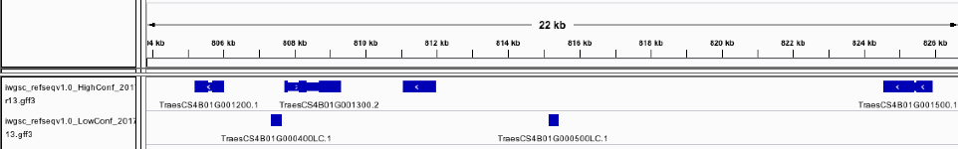
RefSeqv1.0 gene models: nomenclature
 | CSS | TGACv1 | RefSeqv1.0
Release date | IWGSC, 2014 | Clavijo et al., 2017 | IWGSC, 2018
# contigs/ chromosomes | > 1 million | 735,943 | 21 chromosomes + Un
Mean scaffold size | 7.7 kb | 88.7 kb | Chromosomes
Assembly Size | 10.2 Gb | 13.4 Gb | 14.6 Gb
Order | Crude order | Large Bins | “True” physical order
Gene names | Traes_1BL_447468BDE | TRIAE_CS42_7DL_TGACv1_731555_AA2173560 | TraesCS2B01G000100 TraesCS4B01G000400LC
Progressive number in steps of 100s
Notes:
Step of 100s to ensure space in case new genes are identified in between

Slide 38
RefSeqv1.0 gene models: nomenclature
 | CSS | TGACv1 | RefSeqv1.0
Release date | IWGSC, 2014 | Clavijo et al., 2017 | IWGSC, 2018
# contigs/ chromosomes | > 1 million | 735,943 | 21 chromosomes + Un
Mean scaffold size | 7.7 kb | 88.7 kb | Chromosomes
Assembly Size | 10.2 Gb | 13.4 Gb | 14.6 Gb
Order | Crude order | Large Bins | “True” physical order
Gene names | Traes_1BL_447468BDE | TRIAE_CS42_7DL_TGACv1_731555_AA2173560 | TraesCS2B01G000100 TraesCS4B01G000400LC
Species: Tr. aestivum
Accession: Chinese Spring
Annotation
version
Progressive number in steps of 100s
TraesCS4B01G000400LC
Chromosome
assignment
“gene”
Low Confidence gene model

Slide 39
RefSeqv1.0 gene models: LC vs HC
 | CSS | TGACv1 | RefSeqv1.0
Release date | IWGSC, 2014 | Clavijo et al., 2017 | IWGSC, 2018
# contigs/ chromosomes | > 1 million | 735,943 | 21 chromosomes + Un
Mean scaffold size | 7.7 kb | 88.7 kb | Chromosomes
Assembly Size | 10.2 Gb | 13.4 Gb | 14.6 Gb
Order | Crude order | Large Bins | “True” physical order
Gene names | Traes_1BL_447468BDE | TRIAE_CS42_7DL_TGACv1_731555_AA2173560 | TraesCS2B01G000100 TraesCS4B01G000400LC
Species: Tr. aestivum
Accession: Chinese Spring
Annotation
version
Progressive number in steps of 100s
TraesCS4B01G000400LC
Chromosome
assignment
“gene”
Low Confidence gene model
Gene models have been assigned to high confidence (HC) or low confidence (LC) classes based on completeness, similarity to genes represented in protein and DNA databases and repeat content

Slide 40
RefSeqv1.0 gene models: LC vs HC
 | CSS | TGACv1 | RefSeqv1.0
Release date | IWGSC, 2014 | Clavijo et al., 2017 | IWGSC, 2018
# contigs/ chromosomes | > 1 million | 735,943 | 21 chromosomes + Un
Mean scaffold size | 7.7 kb | 88.7 kb | Chromosomes
Assembly Size | 10.2 Gb | 13.4 Gb | 14.6 Gb
Order | Crude order | Large Bins | “True” physical order
Gene names | Traes_1BL_447468BDE | TRIAE_CS42_7DL_TGACv1_731555_AA2173560 | TraesCS2B01G000100 TraesCS4B01G000400LC
/!\ No correspondence between the numbering of HC and LC

Slide 41
RefSeqv1.0: Important notes
 | CSS | TGACv1 | RefSeqv1.0
Release date | IWGSC, 2014 | Clavijo et al., 2017 | IWGSC, 2018
# contigs/ chromosomes | > 1 million | 735,943 | 21 chromosomes + Un
Mean scaffold size | 7.7 kb | 88.7 kb | Chromosomes
Assembly Size | 10.2 Gb | 13.4 Gb | 14.6 Gb
Order | Crude order | Large Bins | “True” physical order
Gene names | Traes_1BL_447468BDE | TRIAE_CS42_7DL_TGACv1_731555_AA2173560 | TraesCS2B01G000100 TraesCS4B01G000400LC
TraesCS4A01G000400
TraesCS4B01G000400
TraesCS4D01G000400
Are NOT homoeologues

Slide 42
RefSeqv1.0: gene models
 | CSS | TGACv1 | RefSeqv1.0
Release date | IWGSC, 2014 | Clavijo et al., 2017 | IWGSC, 2018
# contigs/ chromosomes | > 1 million | 735,943 | 21 chromosomes + Un
Mean scaffold size | 7.7 kb | 88.7 kb | Chromosomes
Assembly Size | 10.2 Gb | 13.4 Gb | 14.6 Gb
Order | Crude order | Large Bins | “True” physical order
Gene names | Traes_1BL_447468BDE | TRIAE_CS42_7DL_TGACv1_731555_AA2173560 | TraesCS2B01G000100 TraesCS4B01G000400LC
# Coding genes | 100,934 | 104,390 | 107,891 HC 161,537 LC

Slide 43
RefSeqv1.0: gene models
 | CSS | TGACv1 | RefSeqv1.0
Release date | IWGSC, 2014 | Clavijo et al., 2017 | IWGSC, 2018
# contigs/ chromosomes | > 1 million | 735,943 | 21 chromosomes + Un
Mean scaffold size | 7.7 kb | 88.7 kb | Chromosomes
Assembly Size | 10.2 Gb | 13.4 Gb | 14.6 Gb
Order | Crude order | Large Bins | “True” physical order
Gene names | Traes_1BL_447468BDE | TRIAE_CS42_7DL_TGACv1_731555_AA2173560 | TraesCS2B01G000100 TraesCS4B01G000400LC
# Coding genes | 100,934 | 104,390 | 107,891 HC 161,537 LC
+ annotated transposable elements (TEs) and non-coding RNAs

Slide 44
RefSeqv1.0 will be available on EnsemblPlants
 | CSS | TGACv1 | RefSeqv1.0
Release date | IWGSC, 2014 | Clavijo et al., 2017 | IWGSC, 2018
# contigs/ chromosomes | > 1 million | 735,943 | 21 chromosomes + Un
Mean scaffold size | 7.7 kb | 88.7 kb | Chromosomes
Assembly Size | 10.2 Gb | 13.4 Gb | 14.6 Gb
Order | Crude order | Large Bins | “True” physical order
Gene names | Traes_1BL_447468BDE | TRIAE_CS42_7DL_TGACv1_731555_AA2173560 | TraesCS2B01G000100 TraesCS4B01G000400LC
# Coding genes | 100,934 | 104,390 | 107,891 HC 161,537 LC
Resources | Archive EnsemblPlants | EnsemblPlants * | (EnsemblPlants)

Slide 45
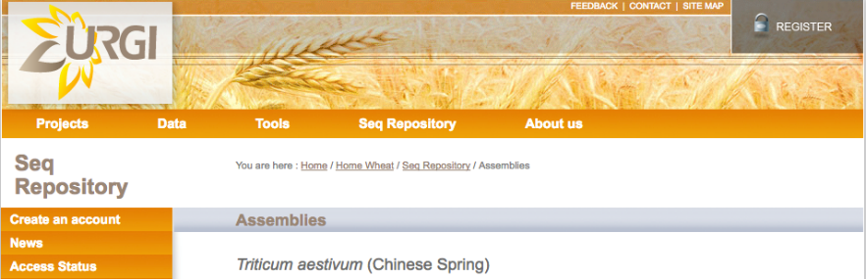
Available at URGI (and very soon EnsemblPlants)
 | CSS | TGACv1 | RefSeqv1.0
Release date | IWGSC, 2014 | Clavijo et al., 2017 | IWGSC, 2018
BLAST available for genome assembly
https://wheat-urgi.versailles.inra.fr/Seq-Repository/Assemblies
https://wheat-urgi.versailles.inra.fr/Seq-Repository/Annotations
No BLAST for annotations: use www.wheat-expression.com

Slide 46
3 generations of wheat genome assemblies
 | CSS | TGACv1 | RefSeqv1.0
Release date | IWGSC, 2014 | Clavijo et al., 2017 | IWGSC, 2018
# contigs/ chromosomes | > 1 million | 735,943 | 21 chromosomes + Un
Mean scaffold size | 7.7 kb | 88.7 kb | Chromosomes
Assembly Size | 10.2 Gb | 13.4 Gb | 14.6 Gb
Order | Crude order | Large Bins | “True” physical order
Gene names | Traes_1BL_447468BDE | TRIAE_CS42_7DL_TGACv1_731555_AA2173560 | TraesCS2B01G000100 TraesCS4B01G000400LC
# Coding genes | 100,934 | 104,390 | 107,891 HC 161,537 LC
Resources | Archive EnsemblPlants | EnsemblPlants * | (EnsemblPlants)
 | TILLING mutants | TILLING mutants | (TILLING mutants)
 | expVIP | expVIP | expVIP + eFP
Accession | Chinese Spring | Chinese Spring | Chinese Spring
Very soon
Very soon
updated
Includes SNP variation, gene trees, homoeolog assignments
TGACv1 on Ensembl: http://plants.ensembl.org/Triticum_aestivum/Info/Index
TILLING mutants: www.wheat-tilling.com
Expression browser: www.wheat-expression.com
More details and tutorials on: www.wheat-training.com
RefSeqv1.0 : https://wheat-urgi.versailles.inra.fr/Seq-Repository/Assemblies

Slide 47
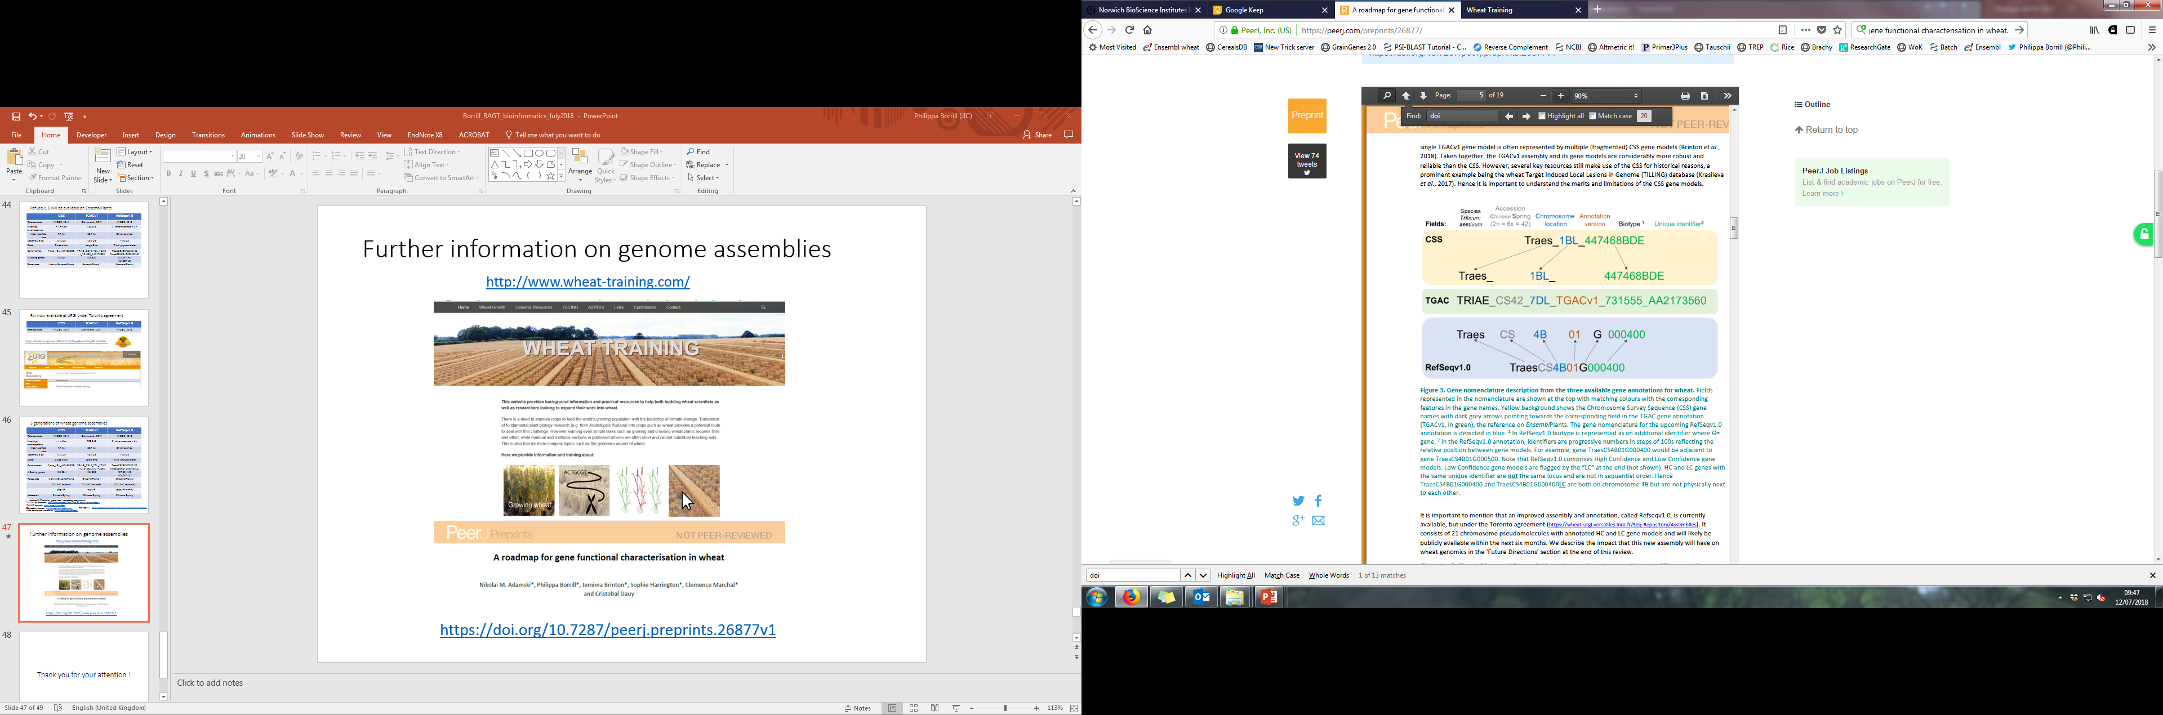
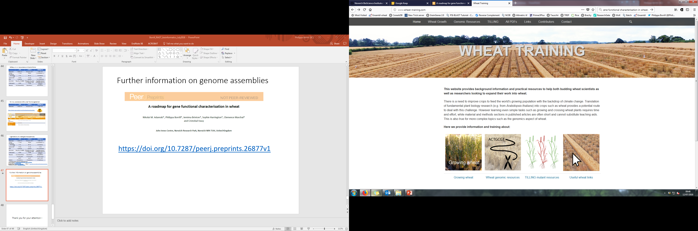
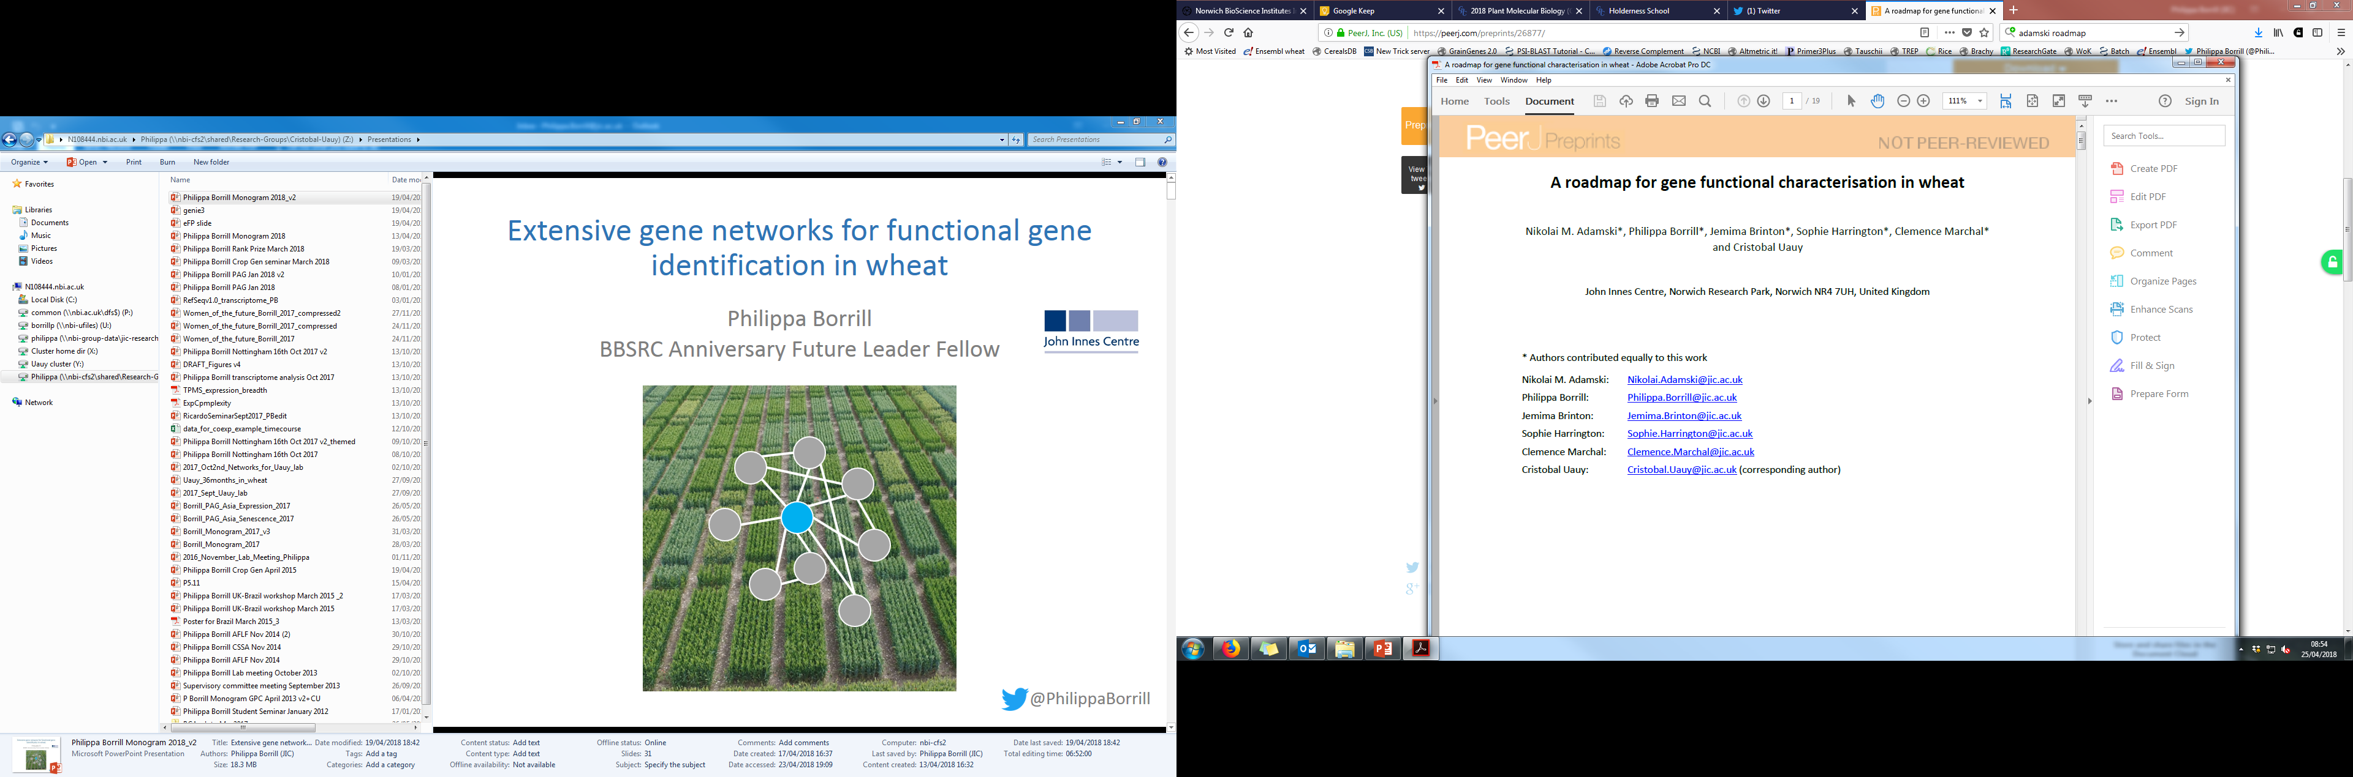
Further information on genome assemblies
http://www.wheat-training.com/
https://doi.org/10.7287/peerj.preprints.26877v1

Slide 48
2. Expression data

Slide 49
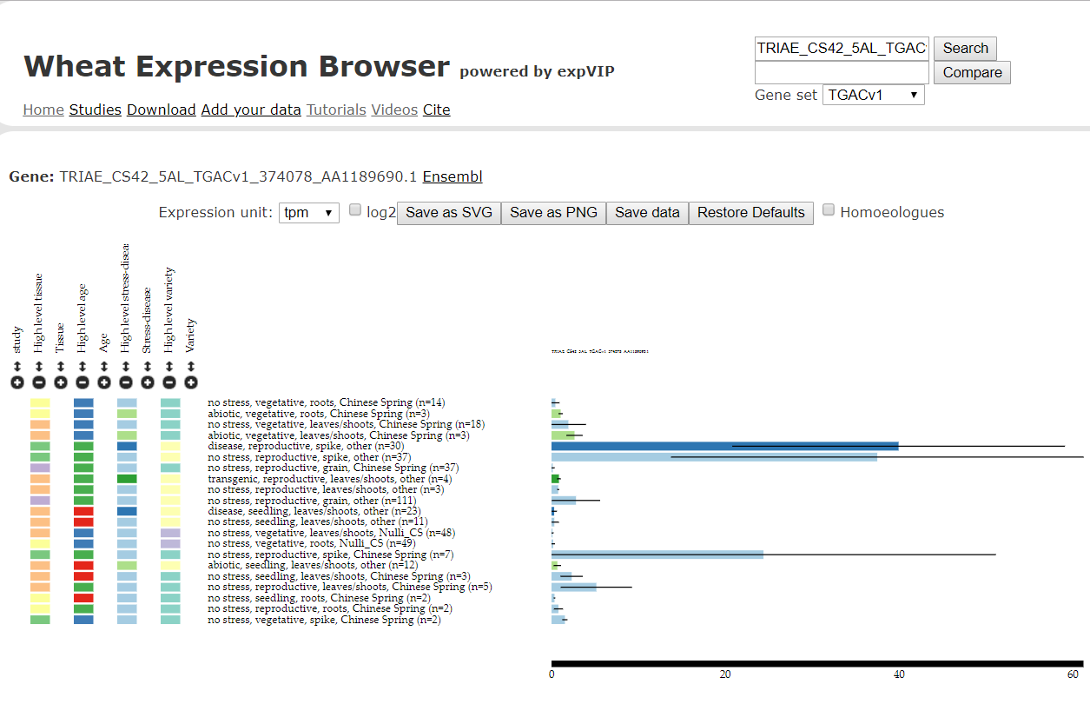
www.wheat-expression.com
Expression in TPM
Borrill et al., 2016, Plant Physiol.

Slide 50
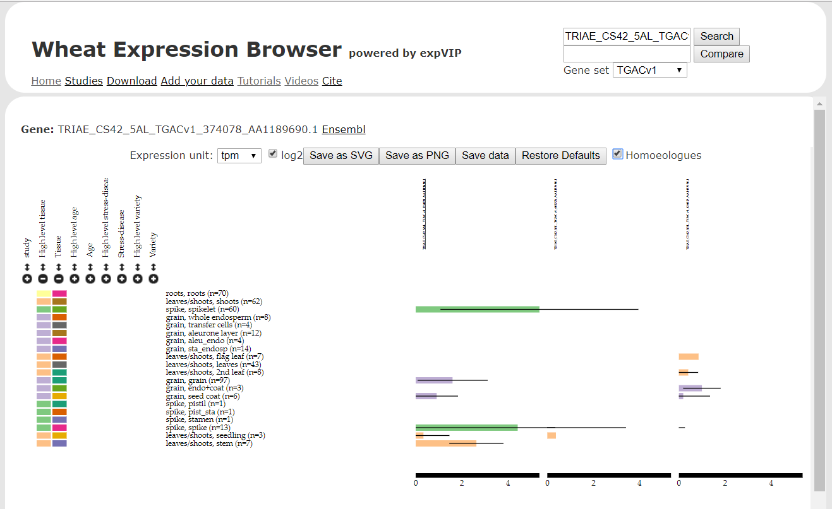
www.wheat-expression.com
Borrill et al., 2016, Plant Physiol.

Slide 51
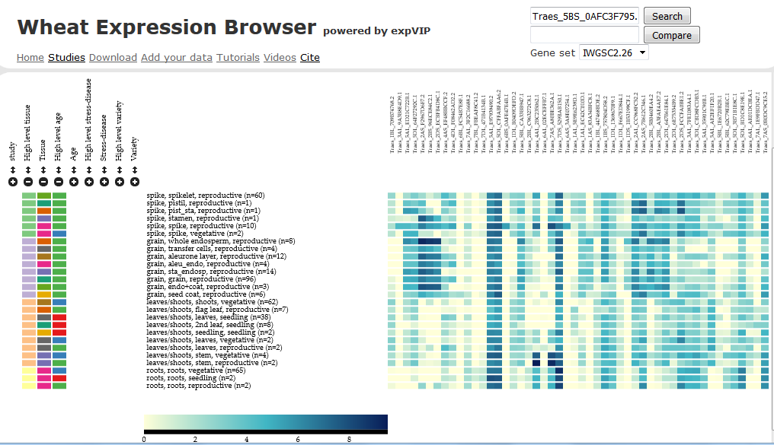
www.wheat-expression.com
Borrill et al., 2016, Plant Physiol.

Slide 52
www.wheat-expression.com – updated
~400 samples
>1000 samples
New gene models:
RefSeq v1.0
TraesCS4B01G000400
RefSeq v1.1
TraesCS4B02G000400
BLAST implemented
Ternary plot implemented

Slide 53
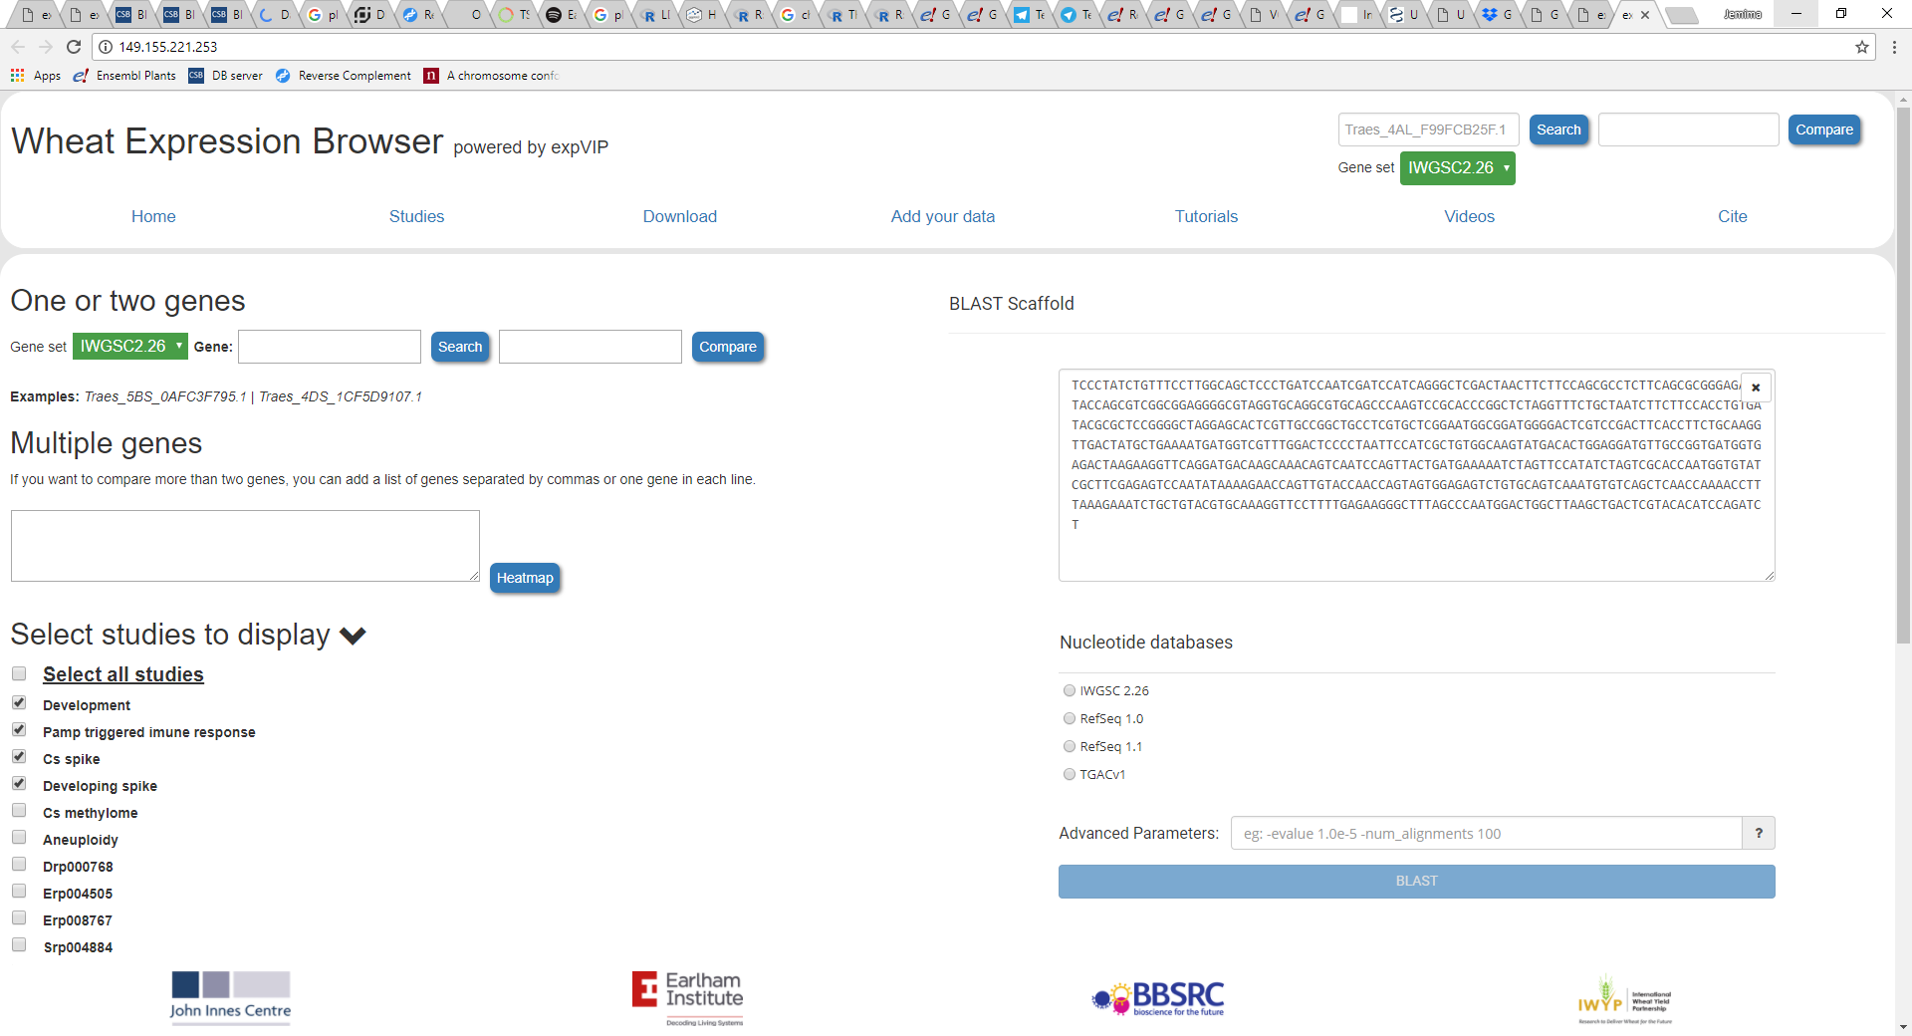
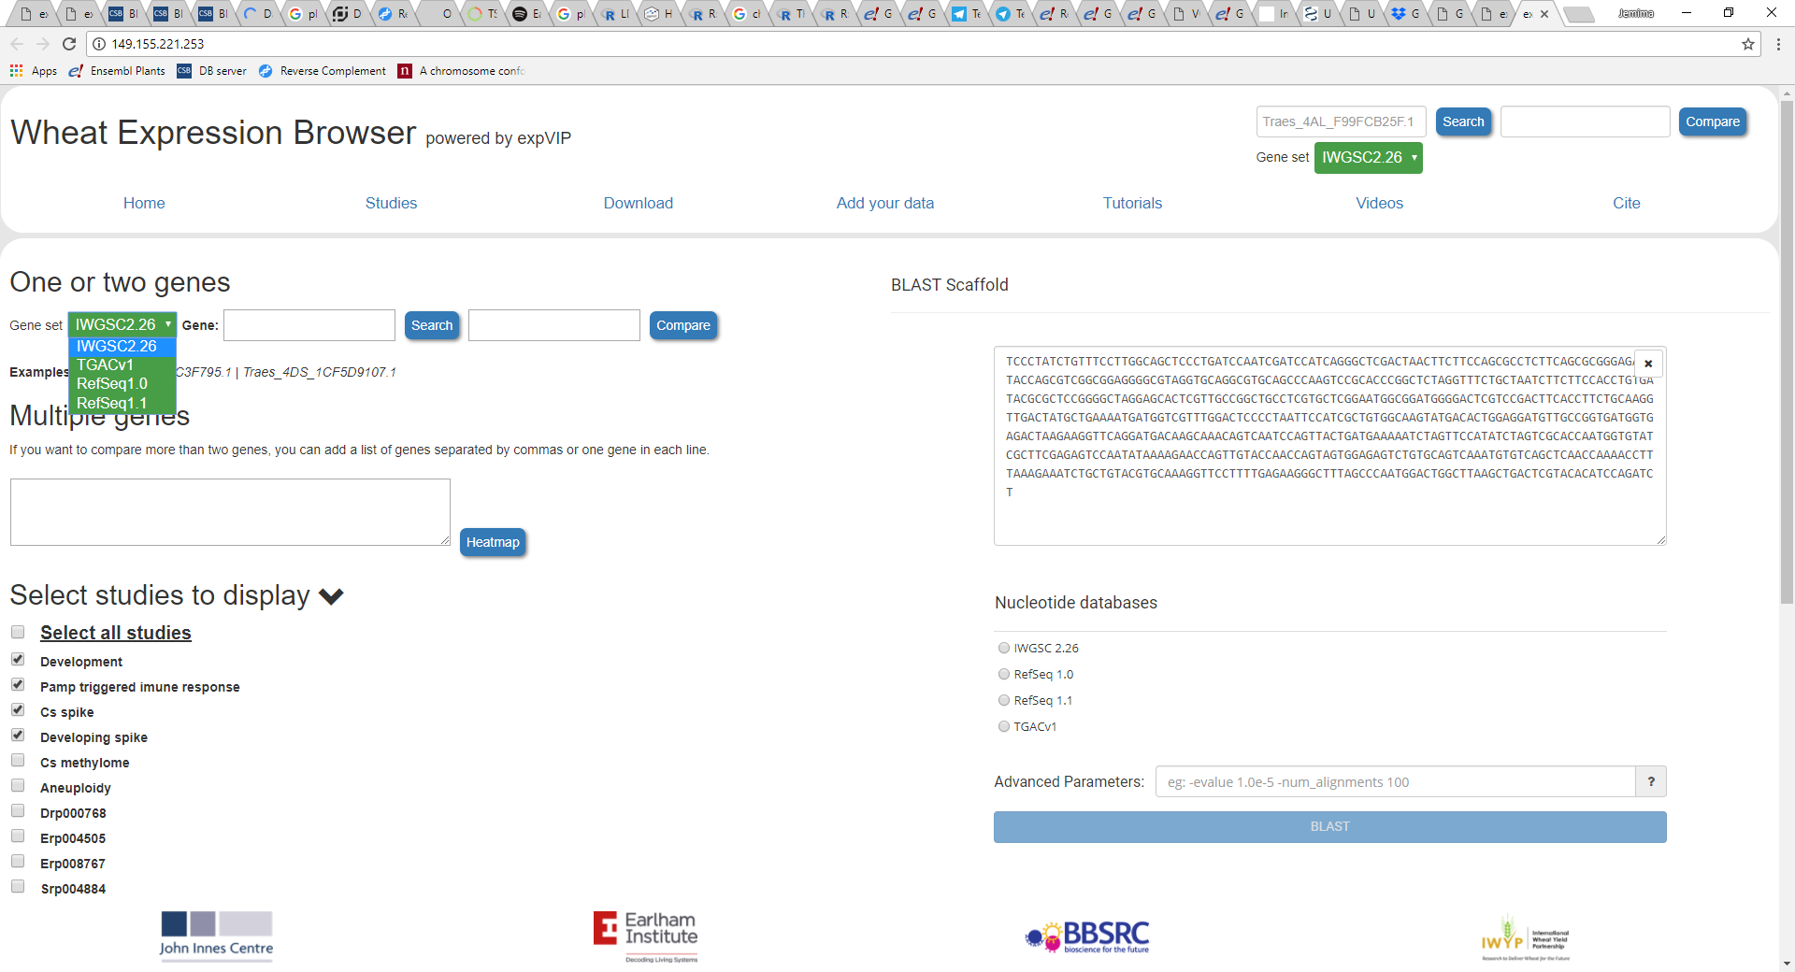
www.wheat-expression.com – updated
RefSeq v1.0 and v1.1 gene models

Slide 54
www.wheat-expression.com – updated
Compare >50 genes at a time

Slide 55
www.wheat-expression.com – updated
More studies added:
Ramirez-Gonzalez, Borrill et al. , 2018, Science (in press)
~30 Studies
~1,000 RNA-Seq samples

Slide 56
www.wheat-expression.com – updated
Find gene by BLAST

Slide 57
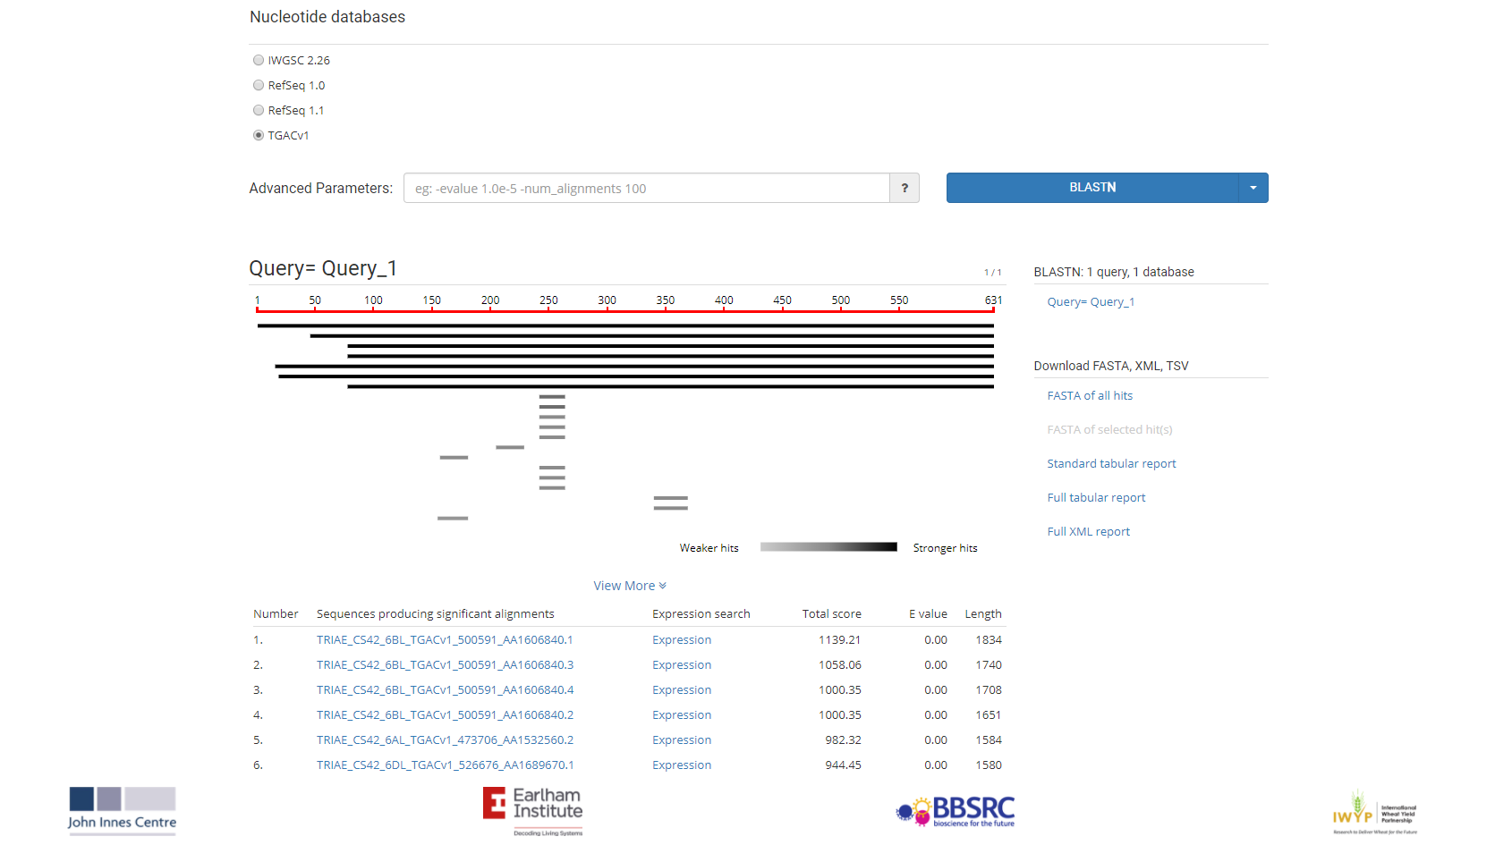
www.wheat-expression.com – updated

Slide 58
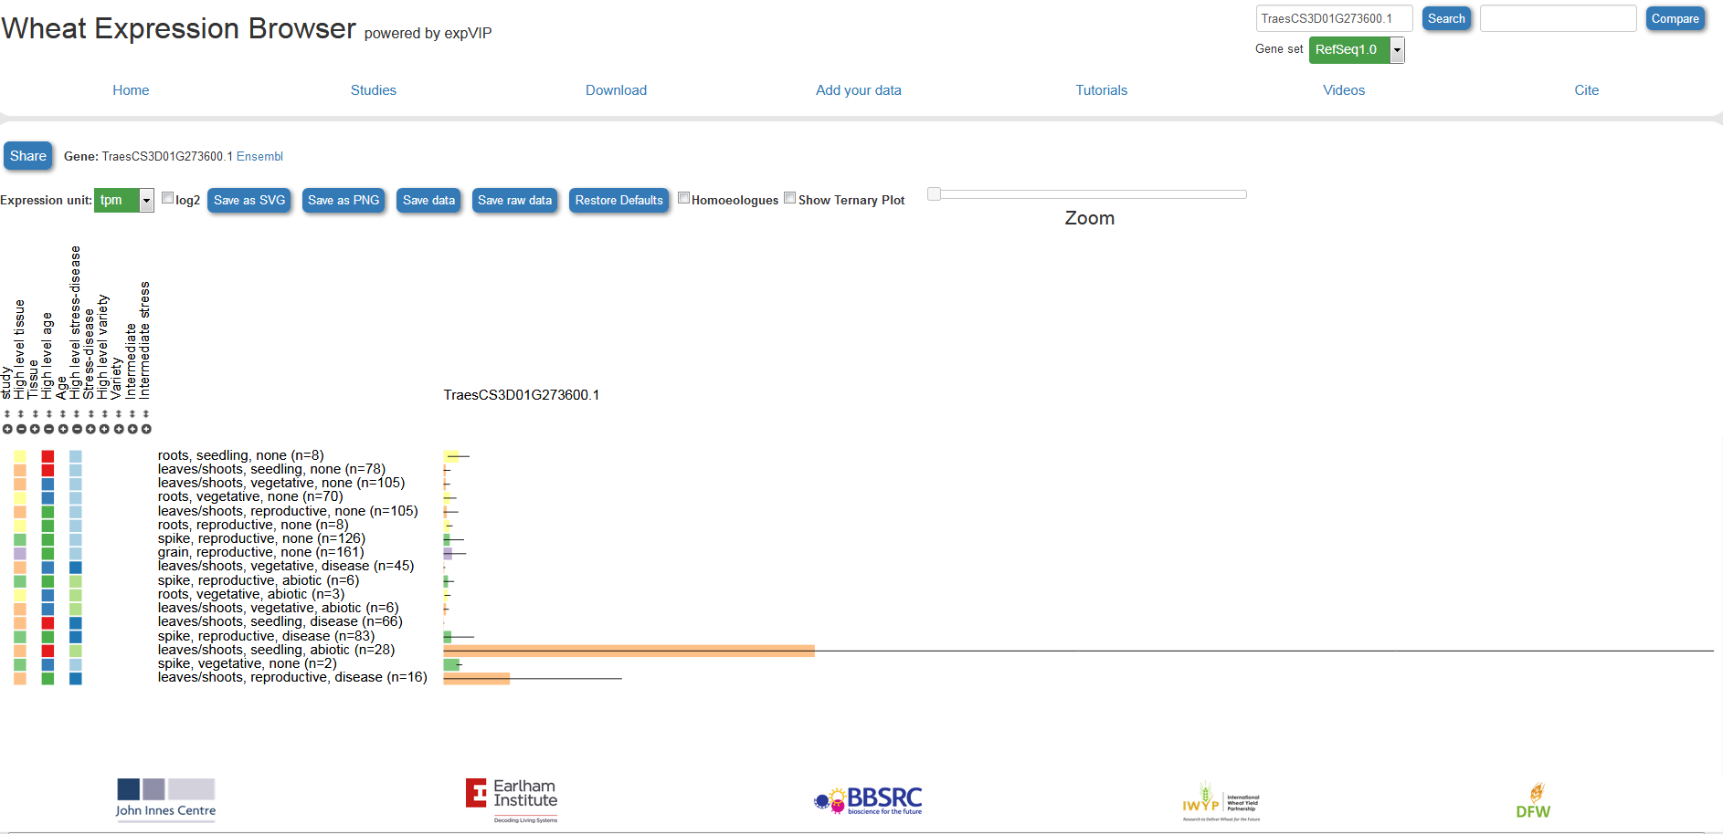
www.wheat-expression.com – updated

Slide 59
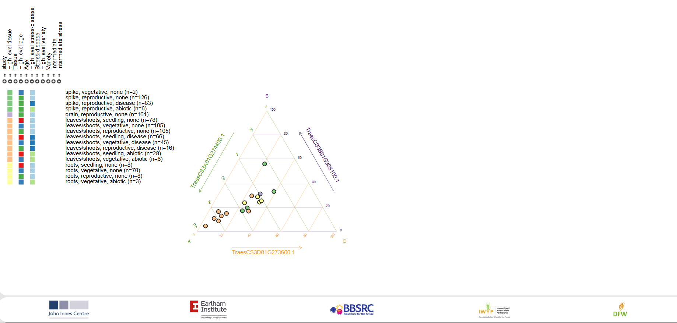
www.wheat-expression.com – updated

Slide 60
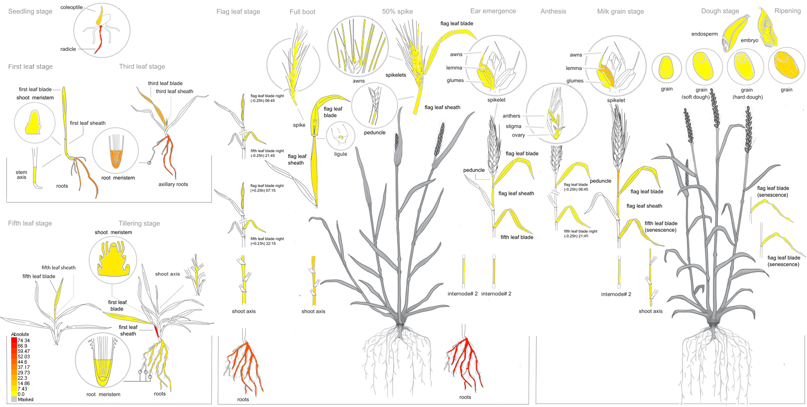



Wheat eFP browser:
http://bar.utoronto.ca/efp_wheat/cgi-bin/efpWeb.cgi
Nicholas Provart
Andy Sharpe
Yogendra Khedikar
Ramirez-Gonzalez, Borrill et al., Science (in press)

Slide 61
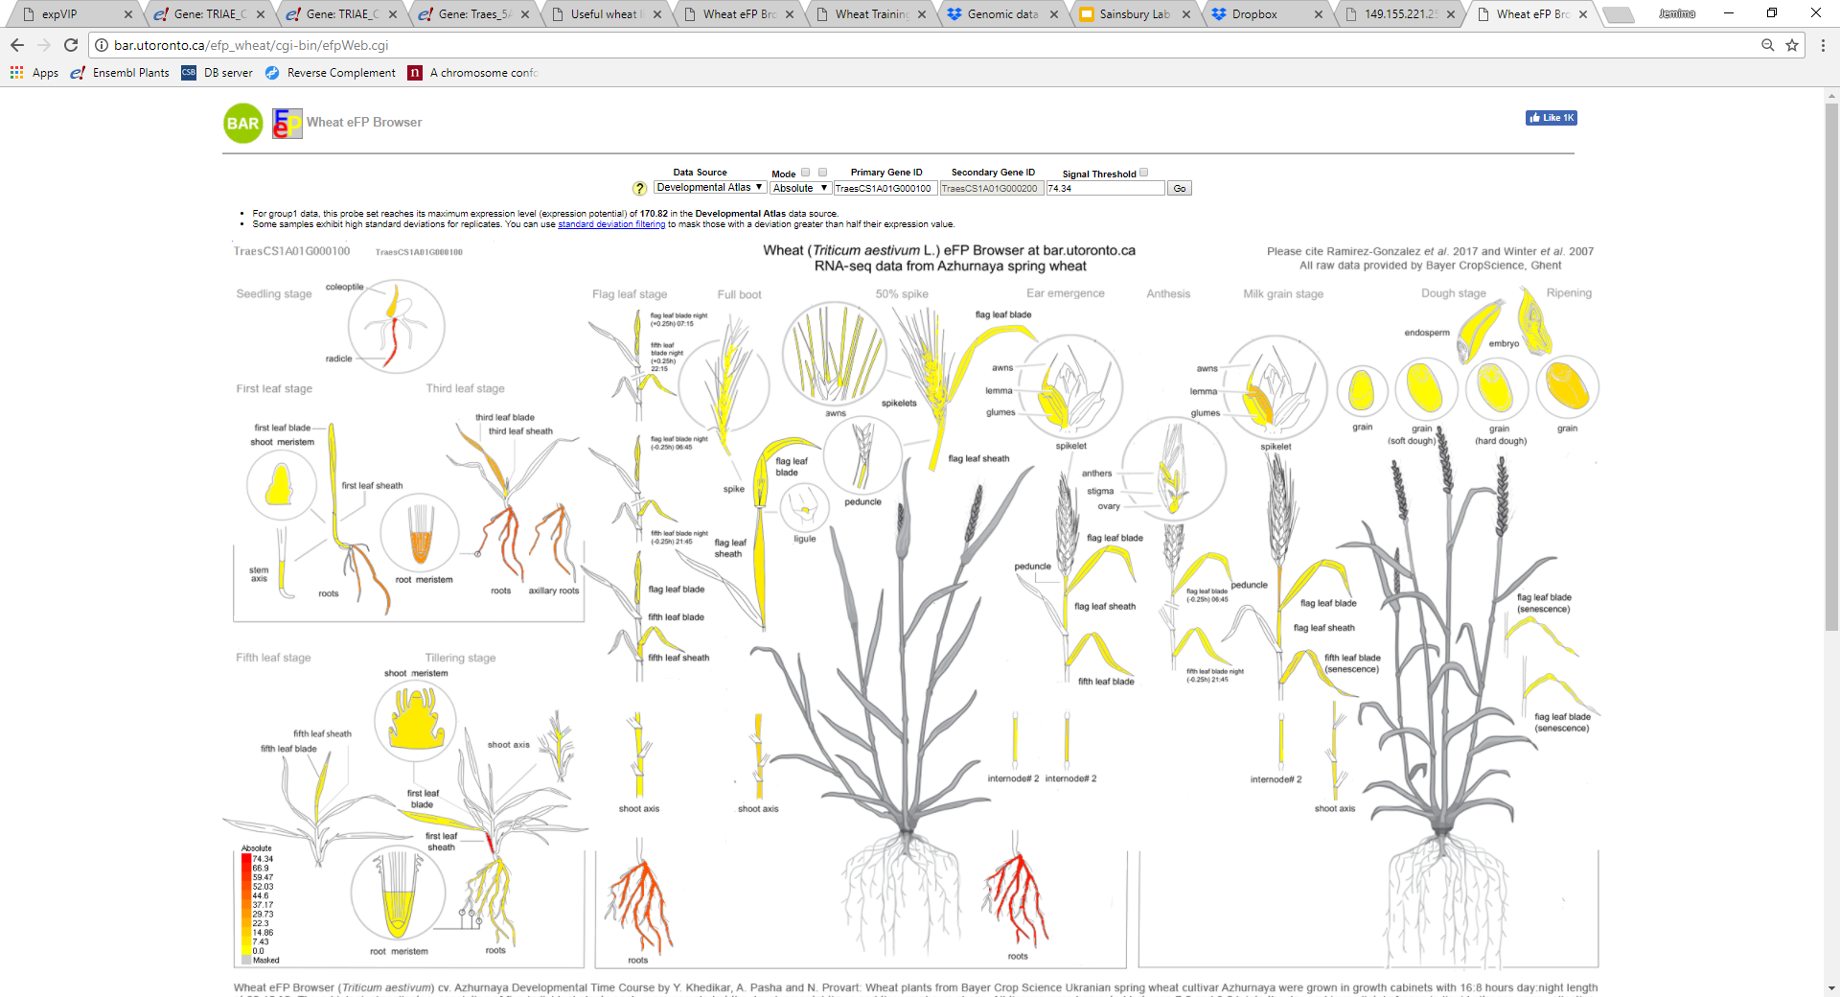
Wheat eFP browser:
http://bar.utoronto.ca/efp_wheat/cgi-bin/efpWeb.cgi
Uses RefSeqv1.0 gene models

Slide 62
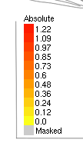
Wheat eFP browser:
http://bar.utoronto.ca/efp_wheat/cgi-bin/efpWeb.cgi
Can set signal threshold

Slide 63
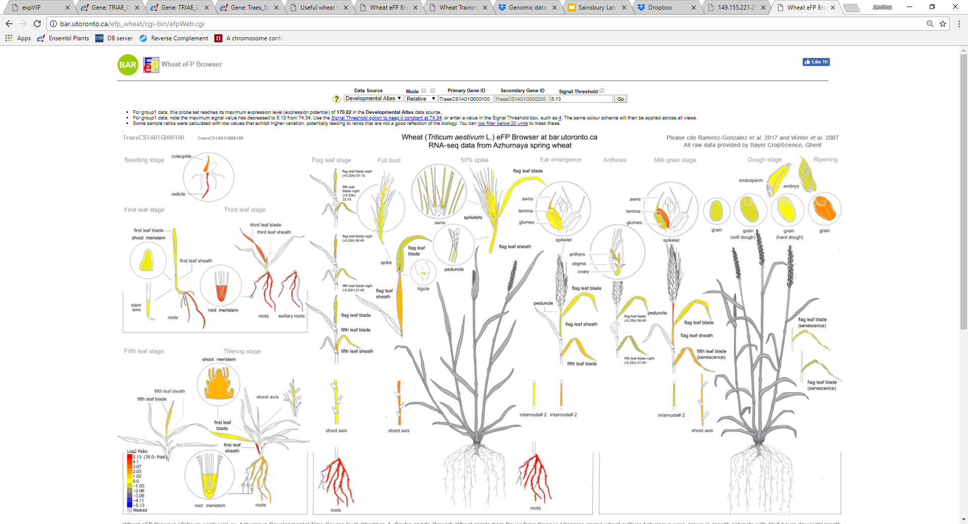
Wheat eFP browser:
http://bar.utoronto.ca/efp_wheat/cgi-bin/efpWeb.cgi
View relative expression level i.e. log fold change

Slide 64
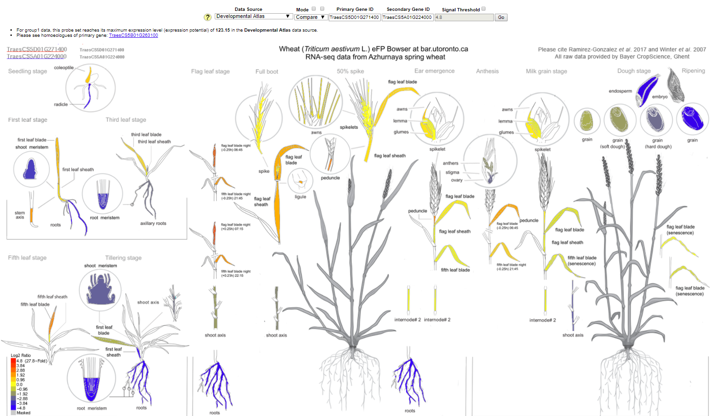
Wheat eFP browser:
http://bar.utoronto.ca/efp_wheat/cgi-bin/efpWeb.cgi
Compare two genes
Top gene is “positive” comparison, bottom gene is “negative” comparison
Higher expression in gene 1
Higher expression in gene 2

Slide 65
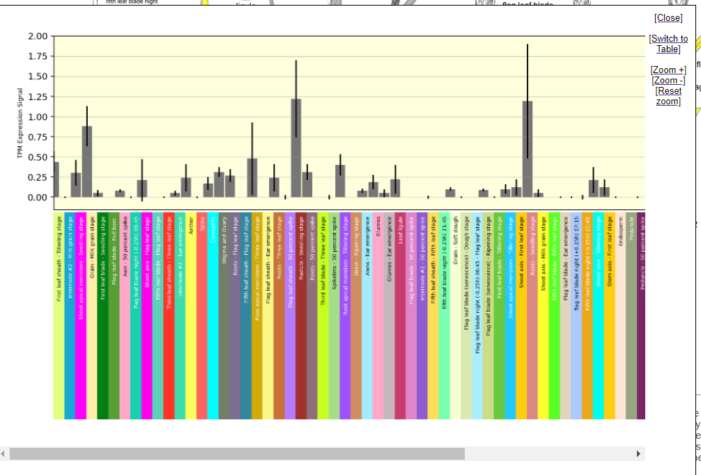
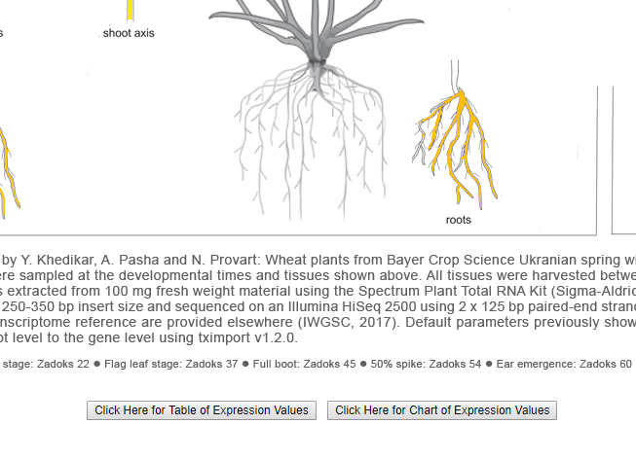
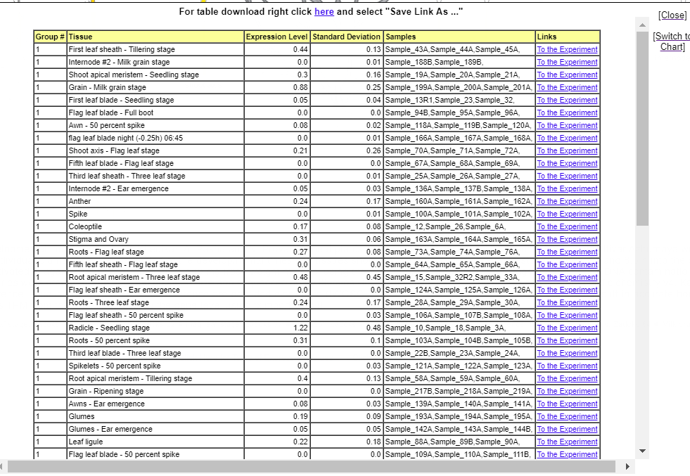
Wheat eFP browser:
http://bar.utoronto.ca/efp_wheat/cgi-bin/efpWeb.cgi
Can download your data as a table and also visualise as a chart

Slide 66
3. Practical session

Slide 67

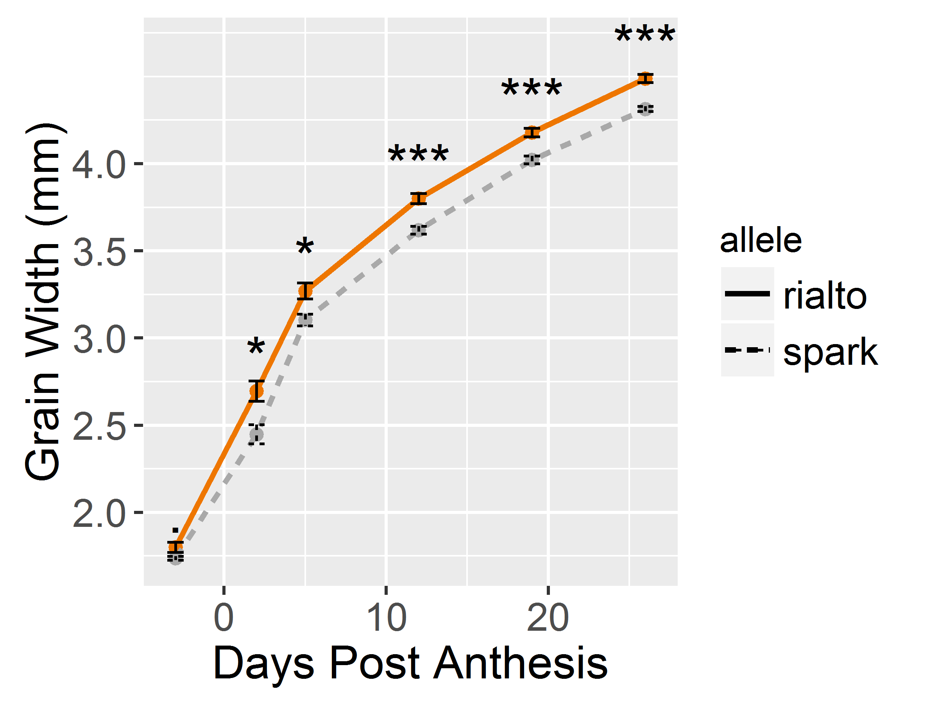
A QTL for grain weight and final yield on chromosome 6A
6A -
6A +
Yield
TGW
6A
Days post anthesis
Simmonds et al, 2014. BMC

Slide 68
A QTL for grain weight and final yield on chromosome 6A
6A -
6A +
Yield
TGW
What is the gene???
Days post anthesis
6A
Simmonds et al, 2014. BMC

Slide 69
Genetic mapping of the 6A grain weight QTL
Chromosome 6A
LOD
Genetic distance (cM)
Mapped to 0.3 cM interval

Slide 70
Practical: Searching for a candidate gene for a grain size QTL using expression data
https://github.com/philippaborrill/expression_training

Slide 72
RefSeqv1.0 gene models: LC vs HC
 | CSS | TGACv1 | RefSeqv1.0
Release date | IWGSC, 2014 | Clavijo et al., 2017 | IWGSC, 2018
# contigs/ chromosomes | > 1 million | 735,943 | 21 chromosomes + Un
Mean scaffold size | 7.7 kb | 88.7 kb | Chromosomes
Assembly Size | 10.2 Gb | 13.4 Gb | 14.6 Gb
Order | Crude order | Large Bins | “True” physical order
Gene names | Traes_1BL_447468BDE | TRIAE_CS42_7DL_TGACv1_731555_AA2173560 | TraesCS2B01G000100 TraesCS4B01G000400LC
Specie: Tr. aestivum
Accession: Chinese Spring
Annotation
version
Progressive number in steps of 100s
TraesCS4B01G000400LC
Chromosome
assignment
“gene”
Low Confidence gene model
Gene models have been assigned to high confidence (HC) or low confidence (LC) classes based on completeness, similarity to genes represented in protein and DNA databases and repeat content
Courtesy of Luca Venturini, Monogram 2017

